Slide 1
we are PeopleBest

Slide 2
PeopleBest ‘cracks the DNA’ of FIT inside people, teams and companies. This enables leaders to know exactly who will succeed inside their role. We analyze a particular job by combing success in any role using actual employees in the job now. We then combine this DNA with our clients Analytics to build the absolute best hiring and culture profiles, beyond anyone else in our field, to ensure our clients uniqueness and absolute success!

Slide 3
How to Build Great ‘FIT’ inside Your Company!
1
2
3
What we have done for others?
How we do it for Clients?
What are the Results!
We have answers for every step of how we can help you!

Slide 4
What we have done for others
1

Slide 5
Define the DNA traits and success factors across Call Center employee populations that reflect success ‘FIT’ inside each role and overall culture of the company in reaching their respective goals. Provide a set of tools that align the whole lifecycle for employees from Hiring, Engagement and Development, to ensure a perfect ‘FIT’ and ultimately happy and engaged people!

Slide 6
some clients - usa

Slide 7
some clients - worldwide

Slide 8
partial sports clients

Slide 9
How we do it for Clients?
2

Slide 10
How We take Clients from DNA to Hiring ‘FIT’ Success
Project Plan
DNA of Population
Analysis with Other Data
Review Results/Analysis
Define Hiring DNA
Implement Online Hiring Process
Job FIT’s/Culture FIT’s
Define Culture DNA

Slide 11
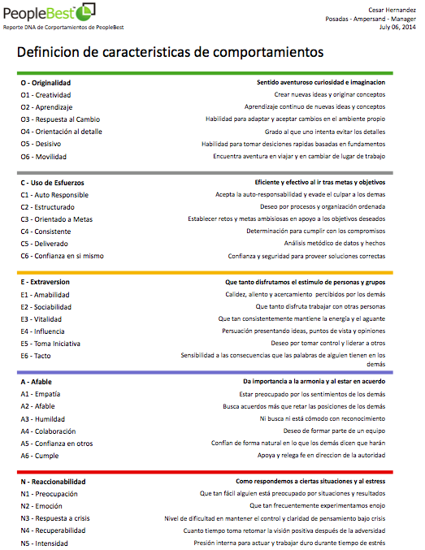
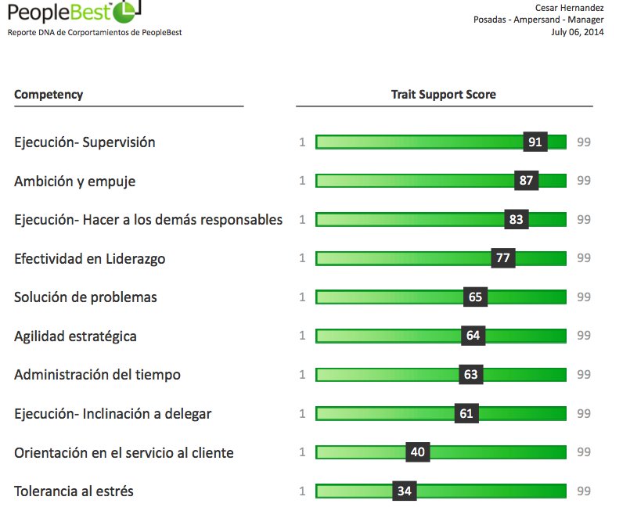
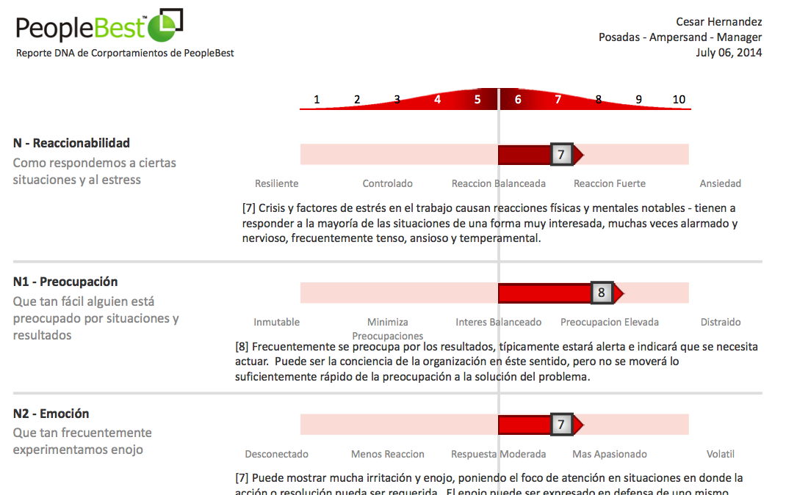
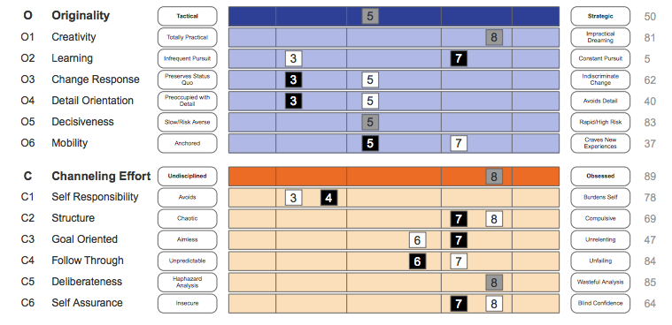
Define DNA: Job FIT and Corporate Culture:

Slide 12
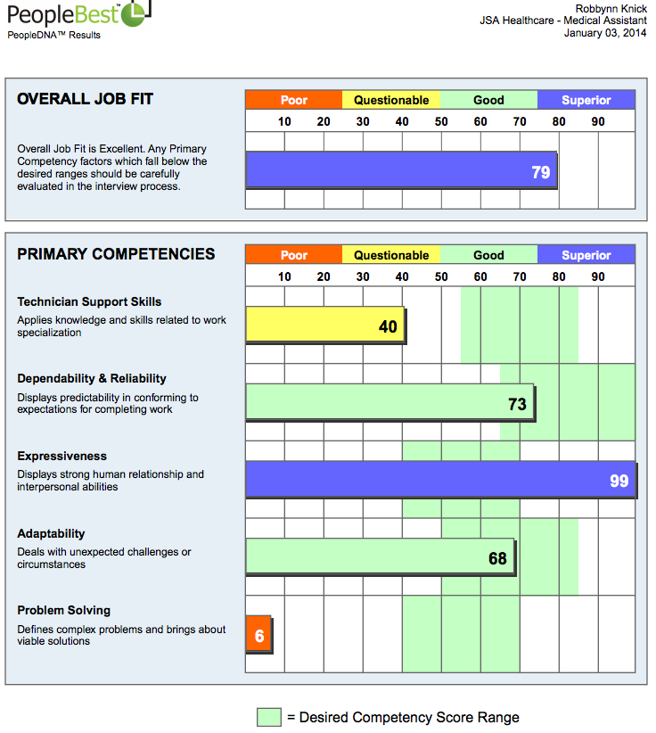
Sample – Hiring Report

Slide 13
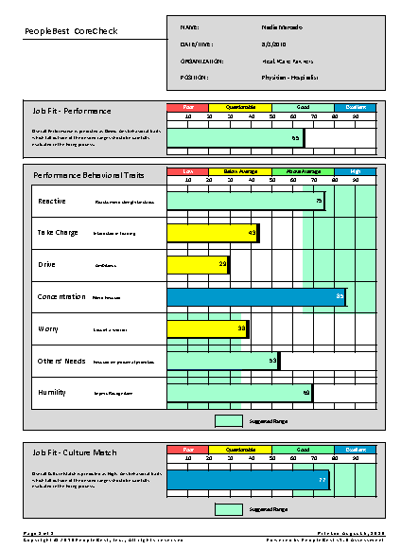
Sample – Hiring & Culture Report

Slide 14
What are the Results?
3

Slide 15
Know the exact DNA ‘FIT’ inside every role! …we also know the exact Culture ‘FIT’ too!
By Identifying both the Job ‘FIT’ and Culture ‘FIT’ of what makes people successful inside our client, hiring and engagement success will drive all parts of the operations and increase human performance.

Slide 16
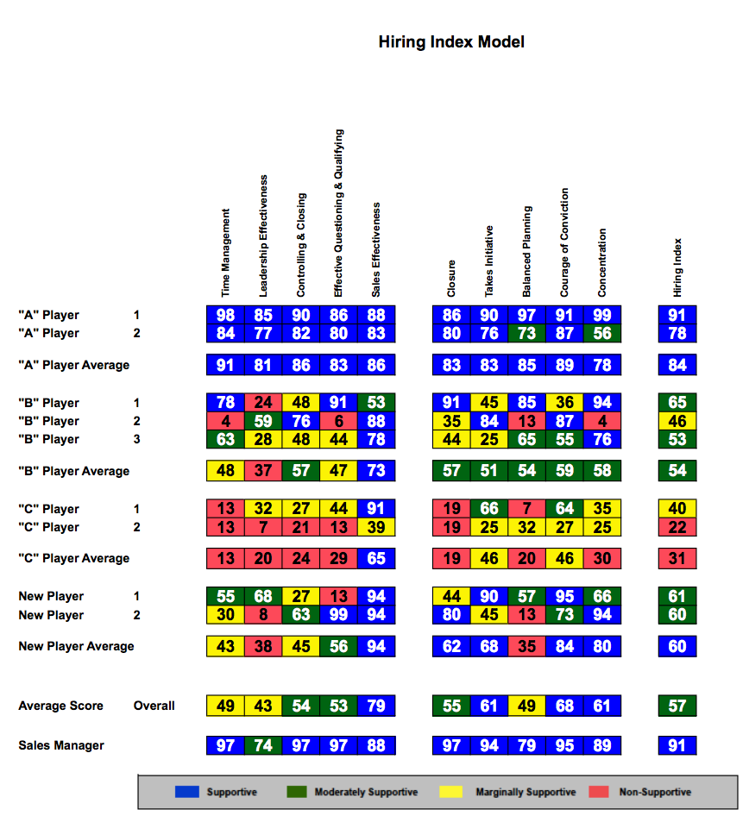
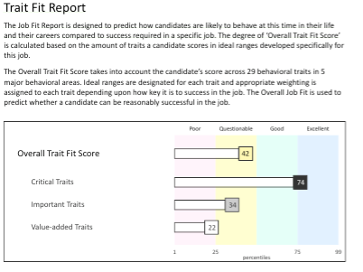
Hiring and Interviewing
Traits and Competencies will be calculated around A,B,C players so that every job will have its own DNA of success!
Simple Interview Guides and Hiring Reports will provide exact scores that will show an overall success score for that person for each role and help hiring managers make better decisions!

Slide 17
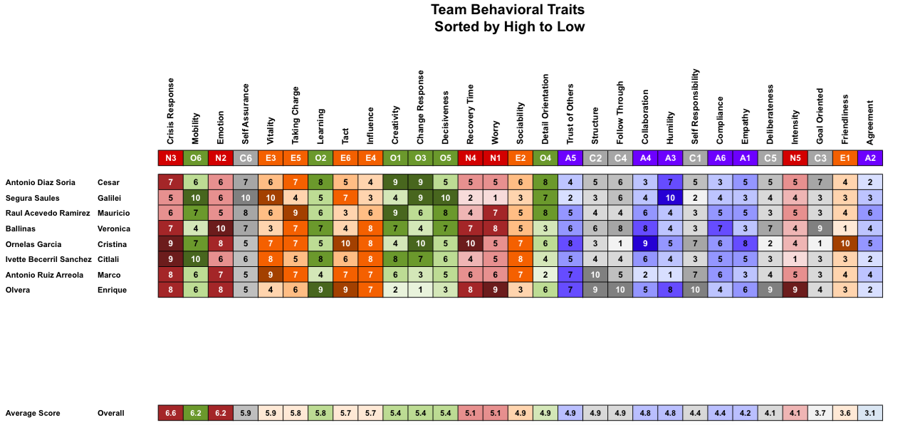
Define DNA: Employee Engagement & Behaviors
Clarity of Direction
Management Effectiveness
Employee Empowerment
Pride in Company
Continuous Improvement
Collaborative Environment or Teamwork
Recognition and Reward
Open Ended Questions
Overall
Index Categories (Comprised of questions from primary categories)
Leadership Index
Communication Index
Engagement Index
Inclusion Index

Slide 18
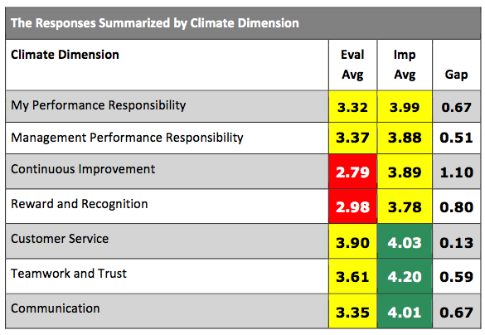
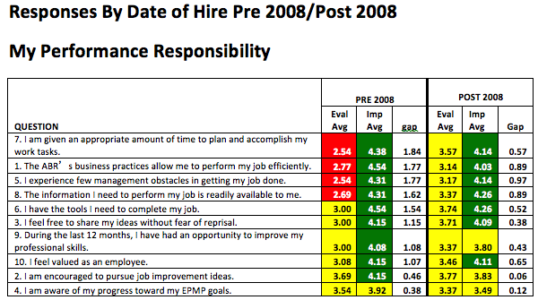
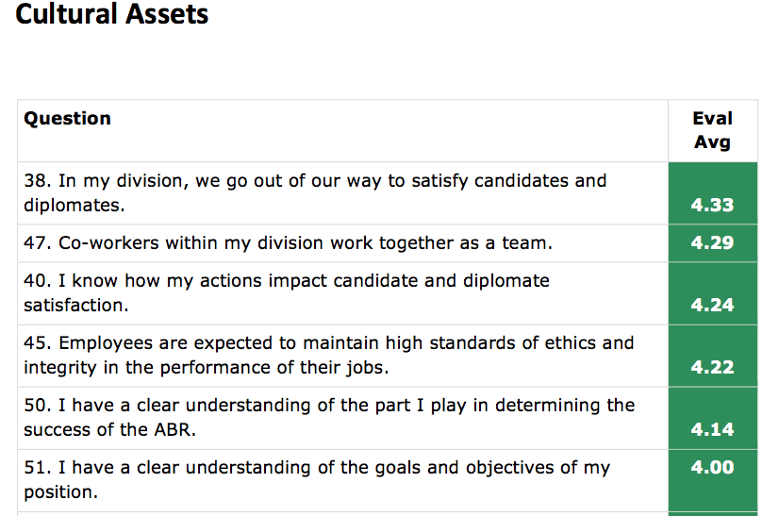
Culture & Engagement
Looking at the overall Culture at every hotel and across every department will provide insights on what is important and where ‘key’ areas need to be fixed. Combing this information with Posadas internal information will provide even more insights as to ‘why’ things are not working or where to fix needed areas.

